Slide 1

Project 1: Sales Data Analysis and Dashboard (Excel/Power BI)
Problem Statement: Analyze a company’s historical sales data to identify key revenue drivers, seasonal trends, and suggest actionable improvements. Visualize insights through interactive dashboards.

Slide 2
Week 1 – Data Collection, Cleaning & Preprocessing in Excel
Step 1: Collect Sample Sales Data
Step 2: Clean the Data
Step 3: Preprocess & Categorize
Step 4: PivotTable Analysis in Excel

Slide 3
Week 2 – KPI Identification and Basic Visualization
Define KPIs
Visualize in Excel
Start Power BI

Slide 4
Week 3 – Build Interactive Power BI Dashboard
Build Visuals

Slide 5
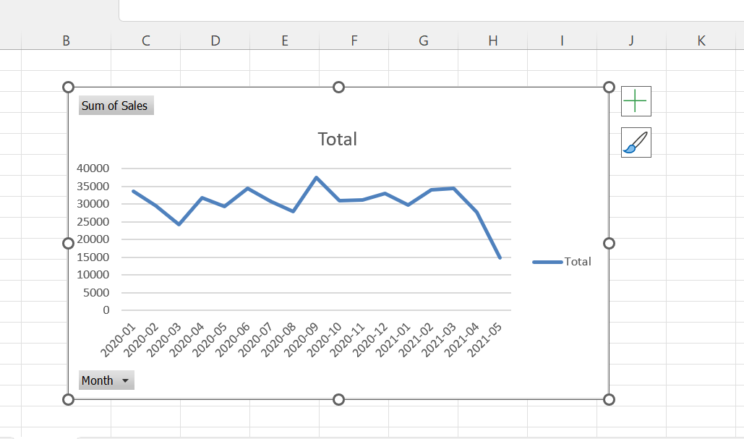

Slide 6
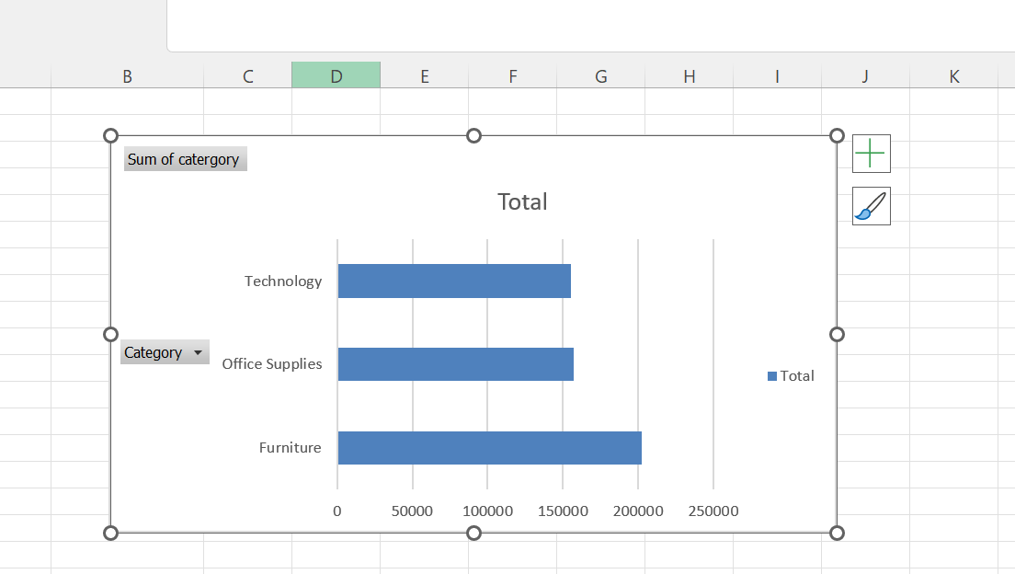

Slide 7
